Slide 1
Asset Management using PowerShell and Power BI
Lexington Pass
May 07, 2019

Slide 2
Contact Info
Email: Joshua.Higginbotham@CodeNameSQL.com
Twitter: @CodeNameSQL
GitHub: https://github.com/jhiggin

Slide 3
What is Asset Management?
The International Association of Information Technology Asset Managers (IAITAM), defines asset management as a set of business practices that incorporates IT assets across the business units within the organization.
ITAM includes a review of current software and hardware used, ensures licensing compliance, and tracks how IT assets are being used and where changes may be needed. An ITAM audit may save you money by identifying software for which you are over licensed or an IT asset you are spending money on, but no longer using.

Slide 4
What does this mean to DBA’s?
Have we over allocated resources to our SQL Servers?
With per core licensing, you can quickly dig yourself a hole if you’re over allocated.
High Ready Times and Co-Stops on virtual environments (Performance Degradation)
Did we install the correct edition of SQL Server?
Do you have developer systems running production copies of SQL Server.
Enterprise edition, without using any of the features.
Are our Maintenance solutions or commonly used scripts installed and up to date?
Ola Hallengren Maintenance Solution
Brent Ozar Scripts
Custom Specials by the office Mad Scientist
What updates have been installed against our Servers?
Could be an indicator as to why you woke up to pitch forks and torches!

Slide 5
What tools will we use?
PowerShell – Used to gather prevalent data across your systems.
Power BI – Presentation layer to make your dataset easier to comprehend.
T-SQL – Logic layer to gather pertinent data from the SQL engine.

Slide 6
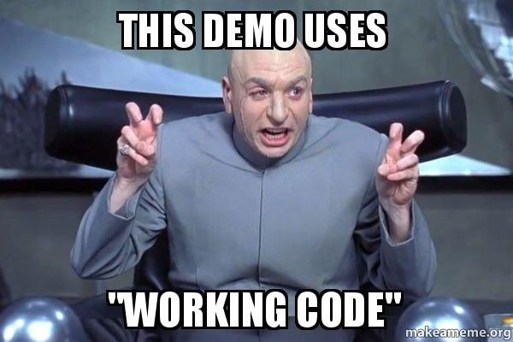
Demos

Slide 7
Questions?

